Slide 1
Crop classification using deep learning
Team Members Group:81 Panel Number:16
Project Advisor: Dr.S.Padmavathi, Associate Professor(SG) , Department of CSE
SNo | Reg.No | Name of the Student | Section
1 | CB.EN.U4CSE18101 | AADHITH S. | CSE B
2 | CB.EN.U4CSE18118 | HAREESH V. | CSE B
3 | CB.EN.U4CSE18163 | VIGNESH H. | CSE B
4 | CB.EN.U4CSE18173 | THARUN KUMAR A. | CSE B

Slide 2

Guide approval mail

Slide 3
Problem statement
Crop identification using deep learning
To develop a web application that would allow users to take images/upload images of different crops, crop fields, identifies the crop using Deep Learning and gives some insight on the crop.

Slide 4
Abstract
The modern lifestyle has made people less aware of where we get our food from. From a commoner’s perspective, it may seem irrelevant but it is our responsibility and is necessary knowledge to know where, when, and how our food is being produced. So, we are designing a web-based application where a user can upload an image to gain insight into the crop.
The workflow is as follows, to decide a few couples of crops whose images are abundantly available, to build a deep learning model, to train the same with the datasets, and to build a user interface. To implement this project, we need to learn the core concepts of deep learning, image processing, and neural networks.
We expect this project to give the users more affinity towards farming and pave a path to bring awareness on agriculture as a profession.

Slide 5
Review 0 comments and the actions taken
Specify how many crops we consider and what they are?
We chose 10 kitchen based crops namely Wheat, Maize, Paddy, Sugarcane, Grape, Tomato, Cucumber, Lemon, Orange and Watermelon.
2. Is it shrub, herb or tree
We are considering a mix of shrub(wheat, maize, paddy, grape, tomato, cucumber, watermelon) and tree(sugarcane, lemon, orange).
3. Is the picture to be individual plant or a group?
We are planning on taking pictures of a single leaf of a plant.
4. What is the view?
We are planning on taking pictures of the leaf on top view.
5. Which stage of crop we consider?
The stage we are considering is almost or ready to harvest stage in shrubs and fully grown tree if it is a tree.

Slide 6
Literature survey (Existing system)
Classification of plant leaf images with complicated background, 2008
Authors: Xiao-Feng Wang, De-Shuang Huang, Ji-Xiang Du, Huan Xu, Laurent Heutte
Inference: Crop identification can be done using the leaf of the plant alone using techniques of automatic marked-controlled watershed segmentation, Otsu thresholding, erosion operation with feature extractors like Hu, Zernike moments and Moving Center Hypersphere (MCH) classifier. This works even for images with overlapping leaves or background interferences like small stones.
Research gap: This method doesn’t work if the image has the plant as a whole or if at least one of the leaves isn’t clearly visible.
[IEEE 2013 20th IEEE International Conference on Image Processing (ICIP) - Melbourne, Australia (2013.09.15-2013.09.18)] 2013 IEEE International Conference on Image Processing - Mobile plant leaf identification using smart-phones
Authors: Bin Wang, Douglas Brown, Yongsheng Gao, John La Salle
Inference: A crop is identified by scanning the image of the leaf of the plant through a newly created method, a novel multiscale shape descriptor which is highly accurate than many general methods at an accuracy of 96.05%.
Research gap: The method doesn’t work if there are any background interference or if the leaves overlap.

Slide 7
3) Leaf plant identification system on hidden naïve bayes classifier, 2015
Authors: Heba F. Eid,Aboul Ella Hassanien
Inference: Crop species are identified using a hidden Bayes Classifier which uses 10 features extracted from leaf shape and leaf vein as input. The model has a high precision of 97 percent when tested against the Flavia dataset.
Research gap: Even though this model has a high accuracy for plant species but doesn't work well when used to identify a plant specifically.
4) Plant identification with convolutional neural networks, 2015
Authors: Sue Han Lee, Chee Seng Chan, Paul Wilkin, Paolo Remagino
Inference: This paper uses a deep learning approach to learn discriminative features from leaf images with classifiers for plants. It also proves that using CNN provides a better feature representation of leaf features compared to hand-crafted features. The model has a high precision of 99.5 percent.
Research gap: Low accuracy when done on plant and not on plant species and also doesn’t work on images having backgrounds.

Slide 8
5) INFOPLANT: Plant Recognition using Convolutional Neural Networks, 2020
Authors: Baizel Kurian Varghese, Albin Augustine, Jubil Maria Babu, Deepa Sunny, Er.Sijo Cherian
Inference: Convolutional Neural networks can be used effectively to extract features from images that help in object detection and classification. From the comparisons with various CNN models, Mobile Net CNN was found to be more effective with an accuracy of 99%.
Research gap: Extracting features of plant parts other than leaf isn't addressed. So given an image of a complete plant or a group of plants as input, the way in which the model would process, extract features from the input image and classify it is not clearly addressed.
6) Image Processing Methods for Identifying Species of Plants, 1995
Authors: Shulin Dave, Ken Runtz
Inference: Frequency domain methods gave results but were time consuming as it depends and varies on when the image was grabbed. Whereas Co-occurrence method worked accurately and effectively than Frequency domain method and also takes less time compared to the former. Fractal dimension method results also vary highly if the orientation of the images are changed.
Research gap: Though there is information on segmenting the image to identify parts of image, no proper information on which part of plant is being analysed to identify the plants.

Slide 9
7) Plant Species Identification Based on Neural Network, 2008
Authors: Lei Zhang, Jun Kong, Xiaoyun Zeng, Jiayue Ren
Inference: SOM neural network is used for identifying plant species.
Research gap: Classification between two different plant species whose leaves have similar dimensions will produce a false identification.
8) Deep Learning for plant identification using vein morphological Patterns, 2016
Authors: Guillermo L. Grinblat, Lucas C. Uzal, M´onica G. Larese and Pablo M. Granitto
Inference: Depth of the convolutional network is a key element for increasing the accuracy of the model.
Research gap: In this paper they consider classifying three different legume species: white bean,red bean and soybean in particular. So classification of other species using this model is questionable.

Slide 10
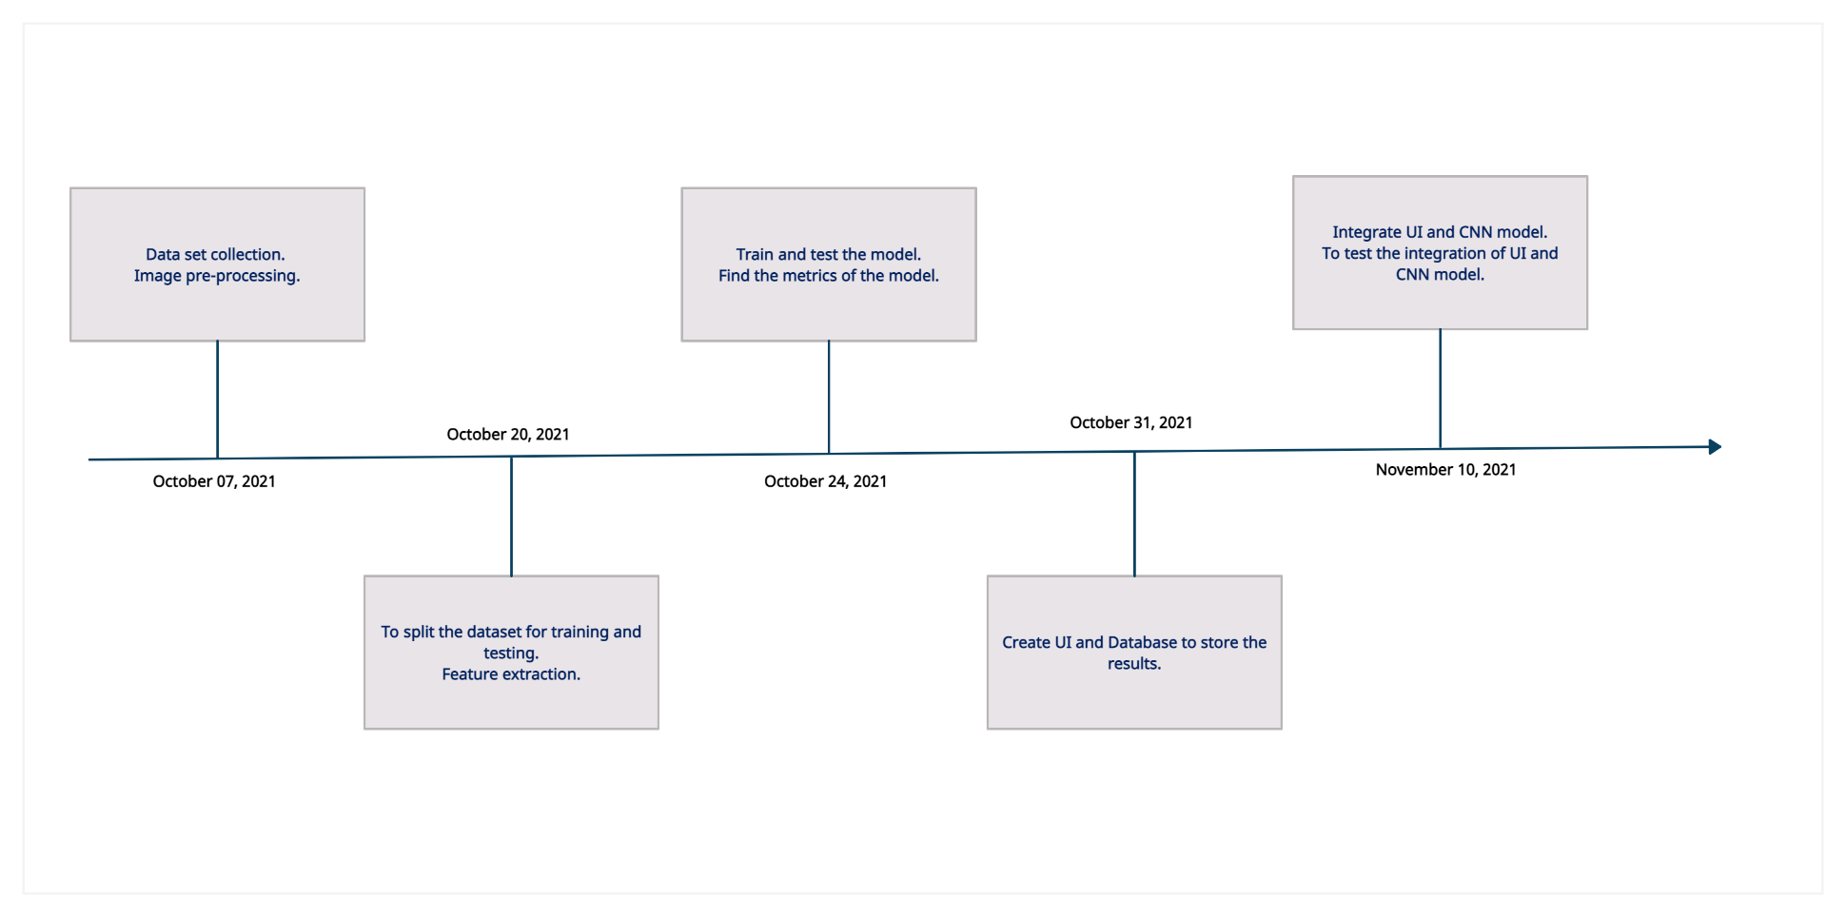
Modularization

Slide 11
Work allocation of team members
S. No. | Task | Team members
1 | Data collection | All members
2 | Image pre-processing | Hareesh and Vignesh
3 | Model creating, training, testing | All members
4 | User Interface | Vignesh and Tharun
5 | Creation of database and integration | Aadhith and Hareesh

Slide 12
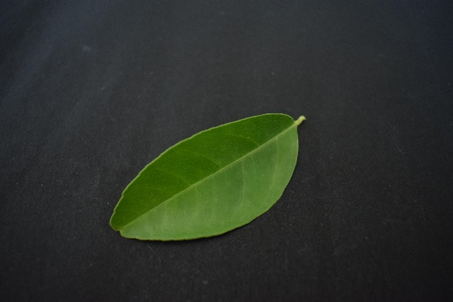
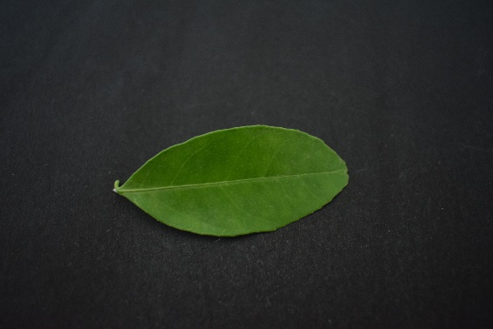
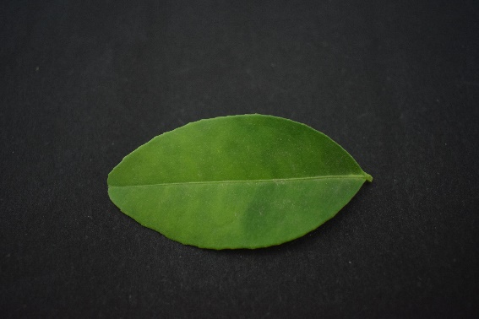
Data Set
Data set link: https://data.mendeley.com/datasets/hb74ynkjcn/1
Crop chosen from the dataset: Lemon (leaf images)
Sample images:

Slide 13
References
M´onica G Larese, Rafael Nami´as, Roque M Craviotto, Miriam R Arango, Carina Gallo, and Pablo M Granitto. Automatic classification of legumes using leaf vein image features. Pattern Recognition, 47(1):158–168, 2014.
Ji-Xiang Du, Xiao-Feng Wang, and Guo-Jun Zhang. Leaf shape based plant species recognition. Applied Mathematics and Computation, 185(2):883–893, 2007. Special Issue on Intelligent Computing Theory and Methodology.
Heng-Nian Qi, Jian-Gang Yang. Sawtooth Feature Extraction of Leaf Edge Based on Support Vector Machine. IEEE. 2003
Joao Camargo Neto, George E. Meyer, David D. Jones, Ashok K. Samal, Plant species identification using Elliptic Fourier leaf shape analysis. Computers and electronics in agriculture 50 (2006) 121-134
C.L. Lee, S.Y. Chen, Classification for leaf images, Proc. 16th IPPR Conf. Comput. Vision Graphics Image Process. (2003) 355–362.

Slide 14
THANK YOU

